Slide 1
Principles of Data Science
Li Niu

Slide 2
Dimensionality Reduction
Motivation:
Reduce time and space complexity
Remove redundant and noisy information
Bypass the curse of dimensionality

Slide 3


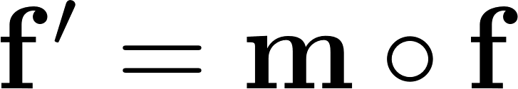
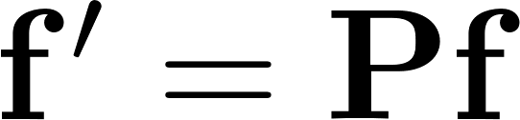
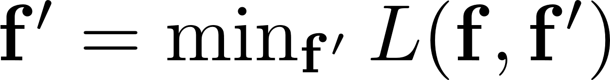
Dimensionality Reduction
Original feature Processed feature
Feature Selection:
Feature projection:
Feature learning:

Slide 4
Feature Selection
Feature projection
Feature learning

Slide 5
Task: predict chances of lung disease
Data: medical history survey
Vegetarian
No
Yes
No
No
Yes
Male
5.8L
Red
Audi
185 lbs
Plays video games
Family history
Athletic
Select the useful features
Smoker
Gender
Lung capacity
Hair color
Car
….
Weight

Slide 6


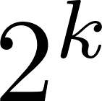
Feature Selection
When mask is binary
If is k-dim, possible feature subsets,
So large searching space.

Slide 7
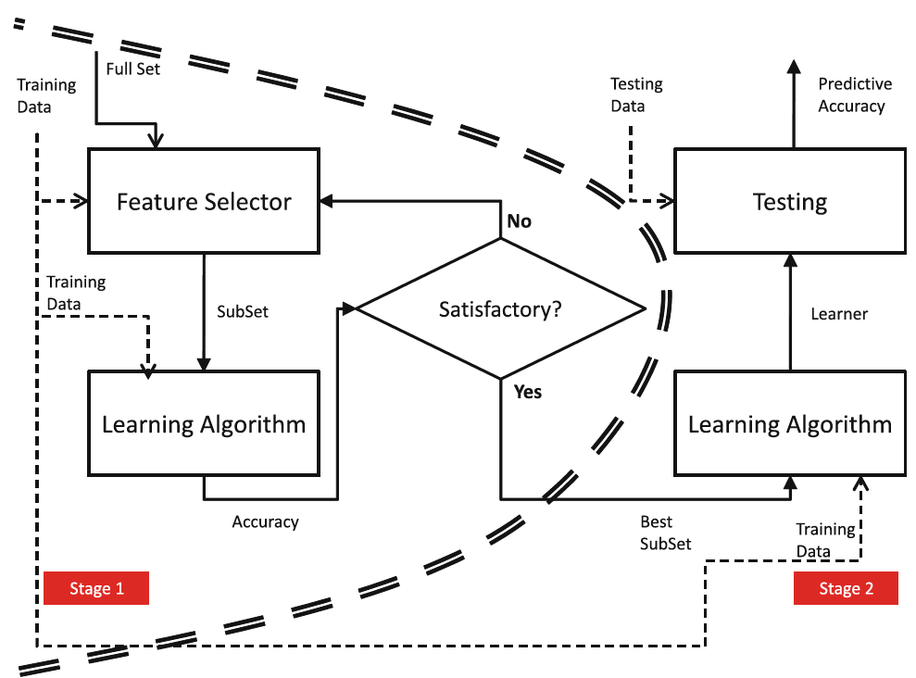
Flowchart of feature selection

Slide 8
Solution:
forward selection
backward elimination
genetic algorithm
….

Slide 9
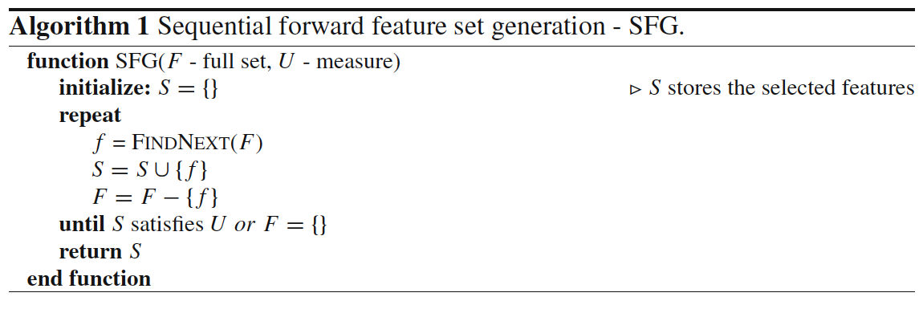
Forward selection

Slide 10
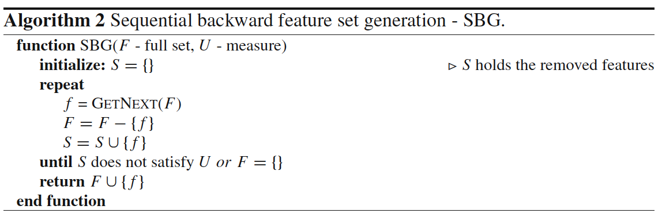
Backward selection

Slide 11
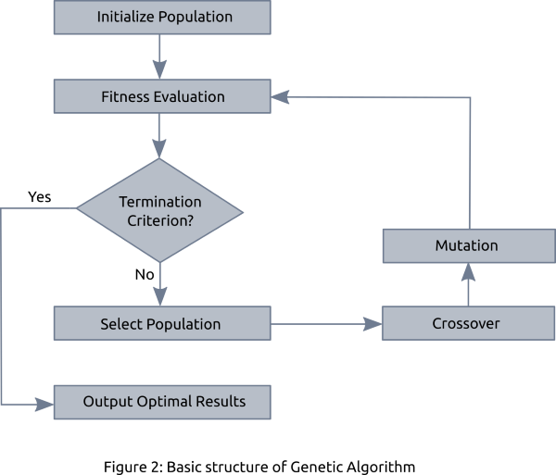
Genetic algorithm

Slide 12
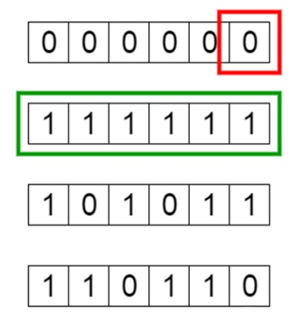
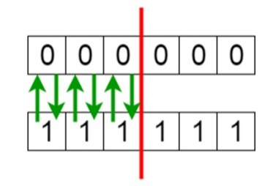

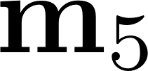
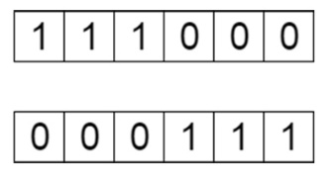


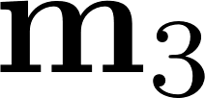

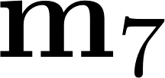
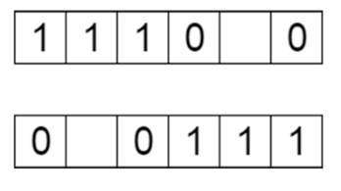


Genetic algorithm
1st generation
population
2nd generation
population
Gene
selection
crossover
Chromosome
mutation

Slide 13
Feature Selection
Feature projection
Feature learning

Slide 14
Feature Projection
Linear projection
Nonlinear projection
Principle Component Analysis (PCA)
Linear Discriminative Analysis (LDA)
Kernel PCA

Slide 15
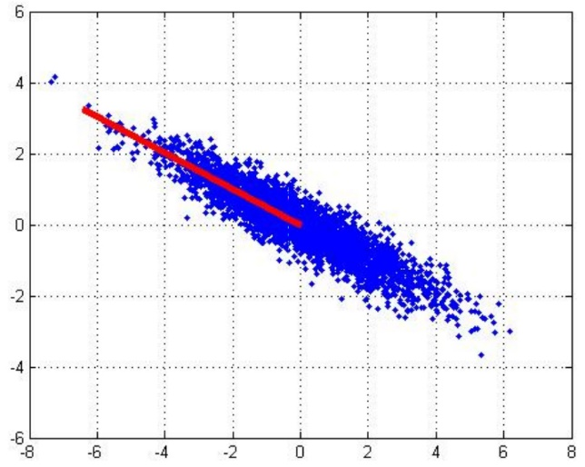
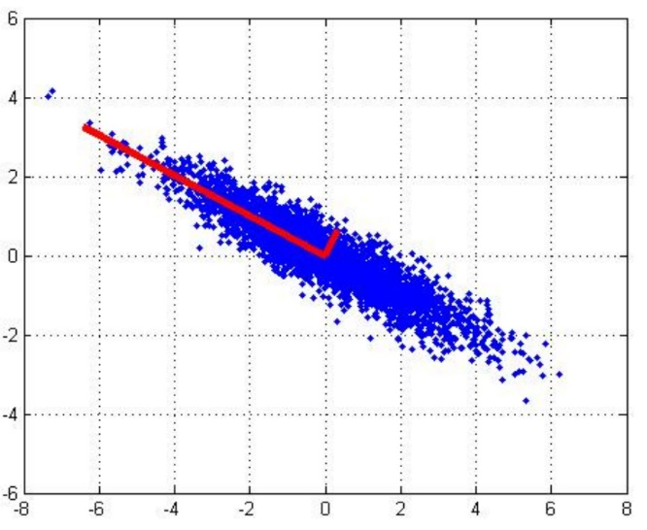
Principle Component Analysis (PCA)
Find the principle component
1st PCA axis
2nd PCA axis

Slide 16

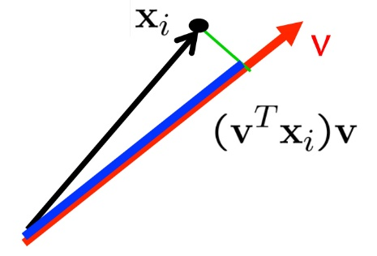
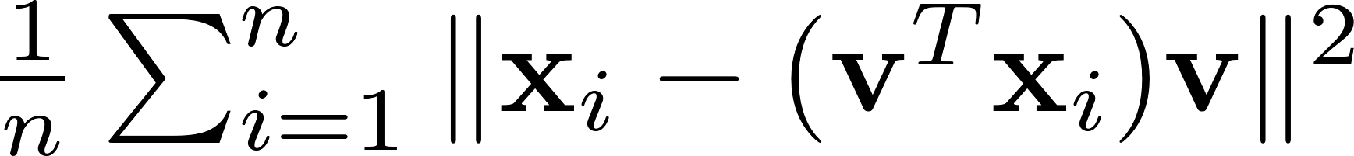
Principle Component Analysis (PCA)
Two interpretations of PCA:
1. Maximum variance direction: when is decentralized
2. Minimum reconstruction error

Slide 17
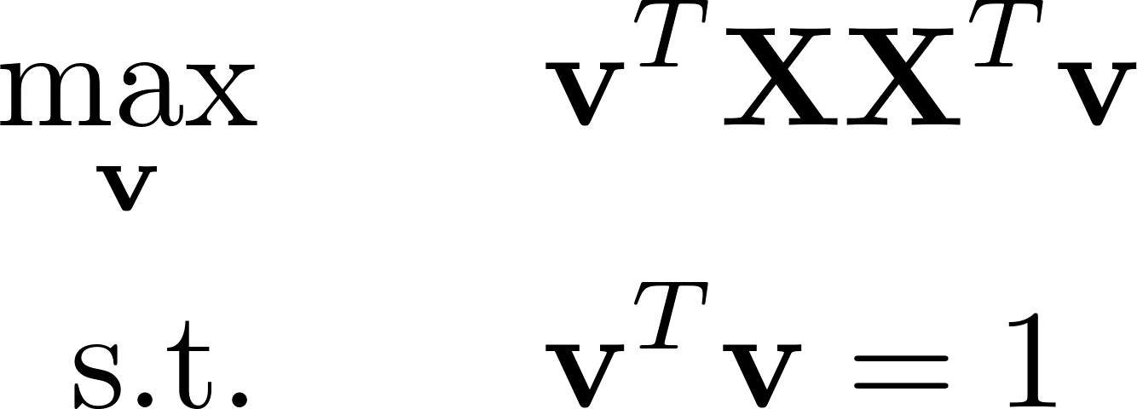
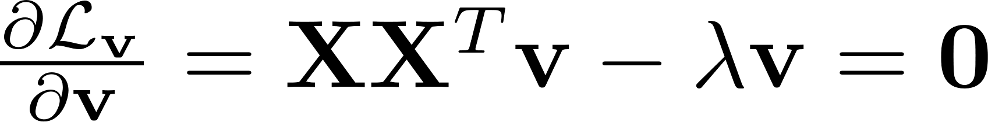

Principle Component Analysis (PCA)
Maximum variance direction: when is decentralized
Lagrangian form:
Eigen decomposition

Slide 18
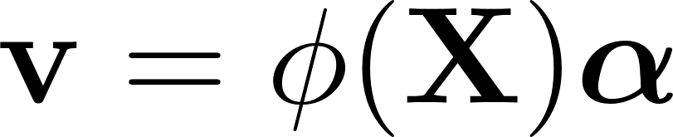
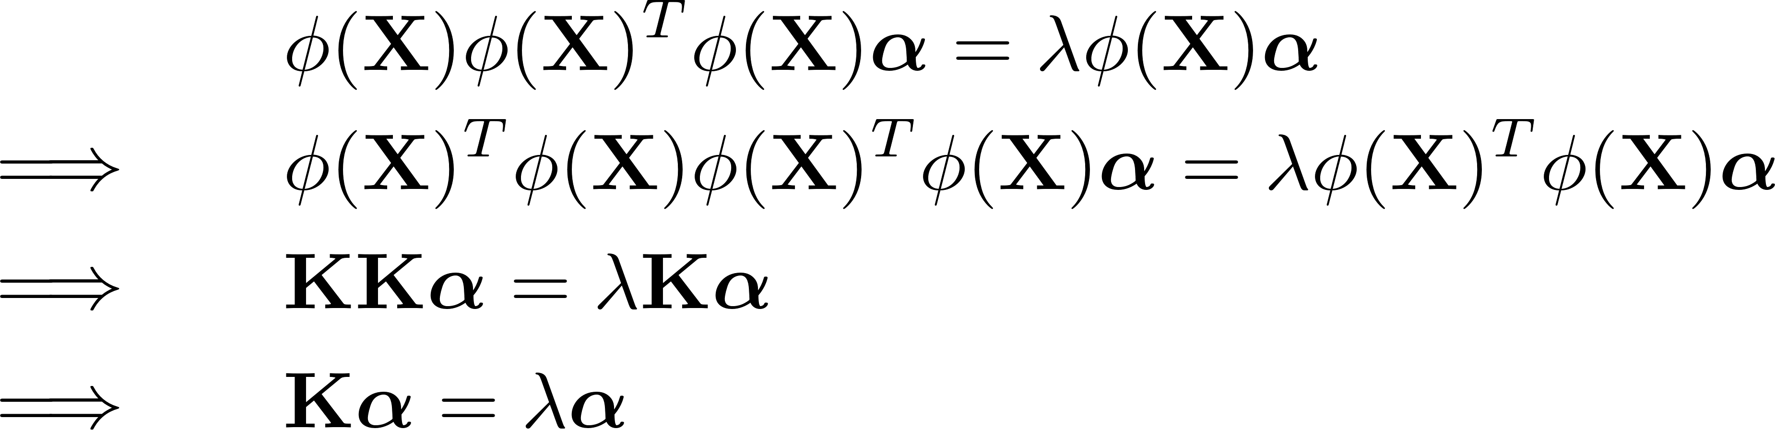
Principle Component Analysis (PCA)
Kernel PCA

Slide 19
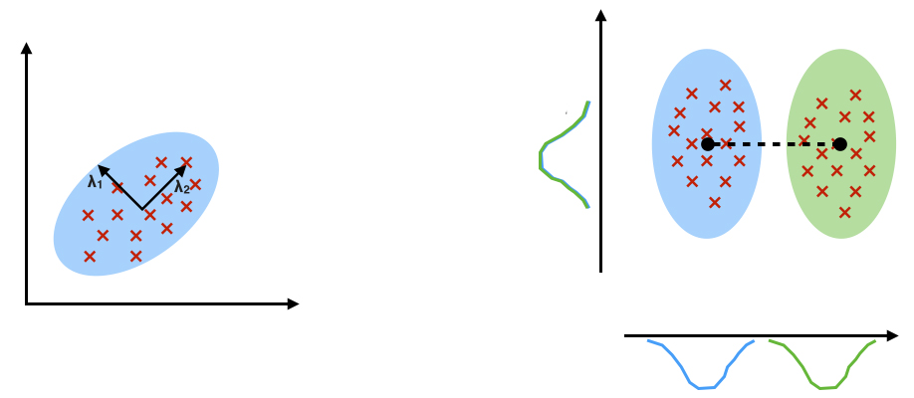
Linear Discriminative Analysis (LDA)
PCA: component axis that maximize the variance
LDA: component axis that maximize the class separation

Slide 20
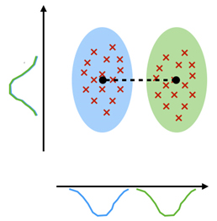
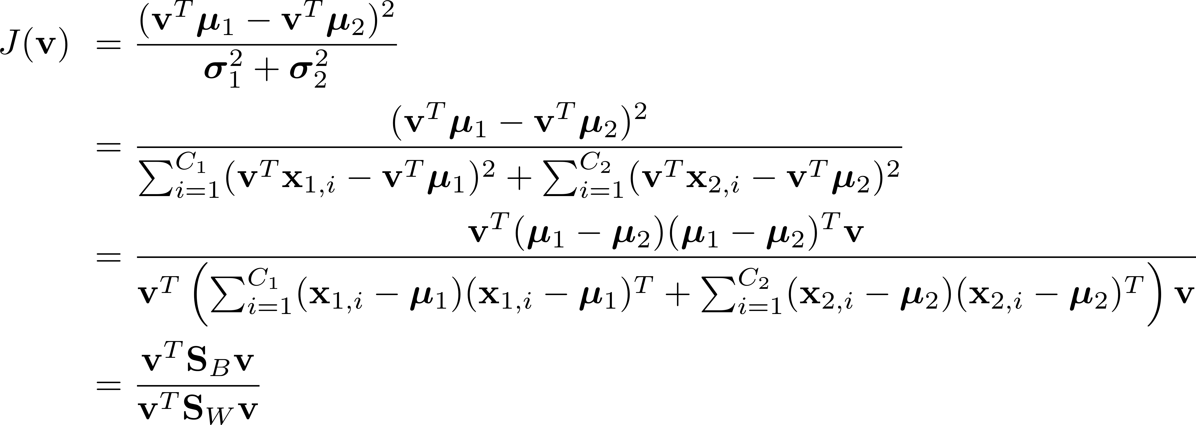
Linear Discriminative Analysis (LDA)
Fisher discriminative analysis
optimal component axis
covariance matrix

Slide 21
Feature Selection
Feature projection
Feature learning

Slide 22



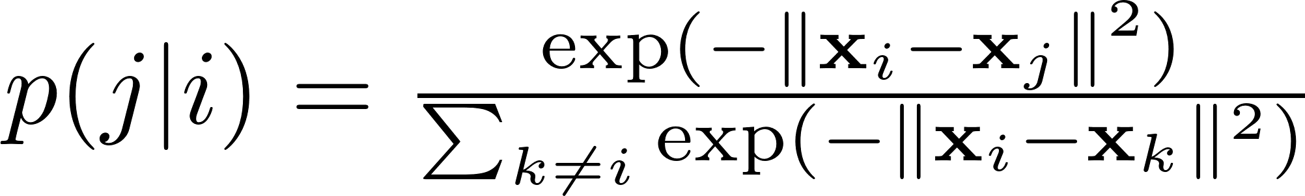
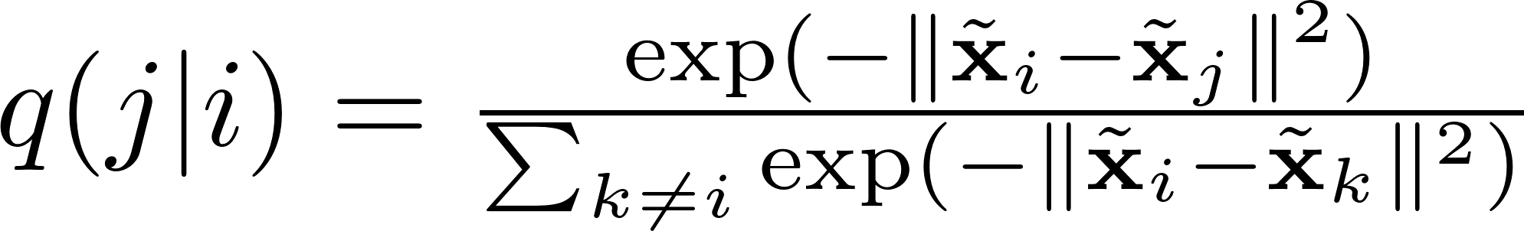
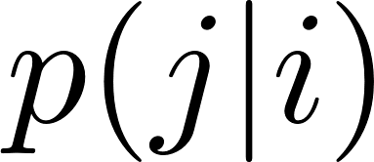
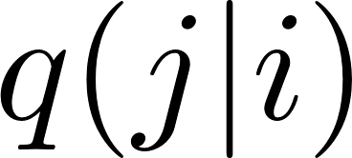
Stochastic Neighborhood Embedding (SNE)
Obtain from : , maintain the relative distance.
should be close to

Slide 23
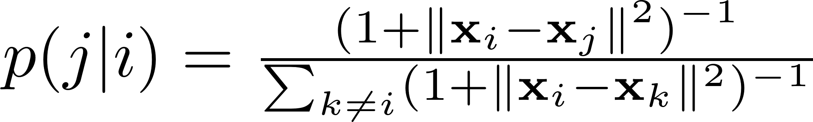
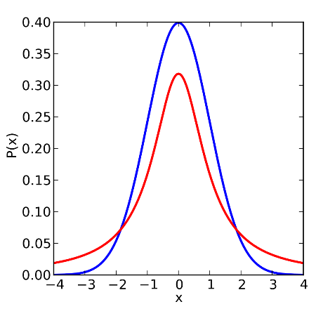
Stochastic Neighborhood Embedding (SNE)
t-SNE: SNE with t-distribution, replace Gaussian distribution with t-distribution (degree of freedom is 1)
Gaussian distribution (thin tail)
t-distribution (heavy tail)

Slide 24
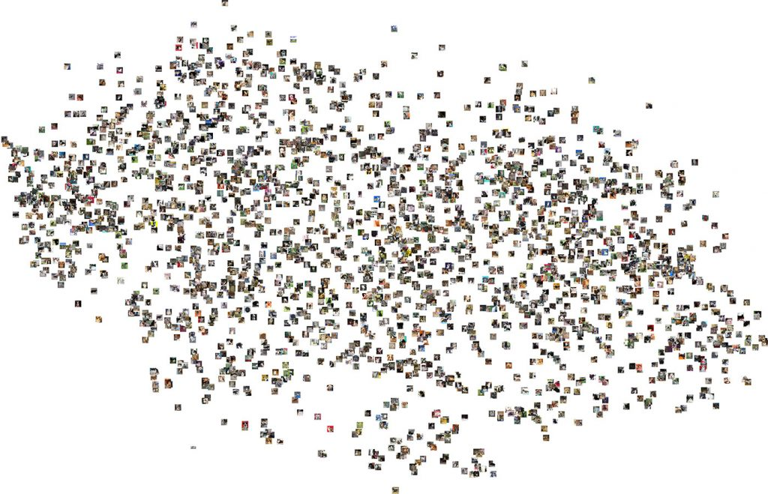
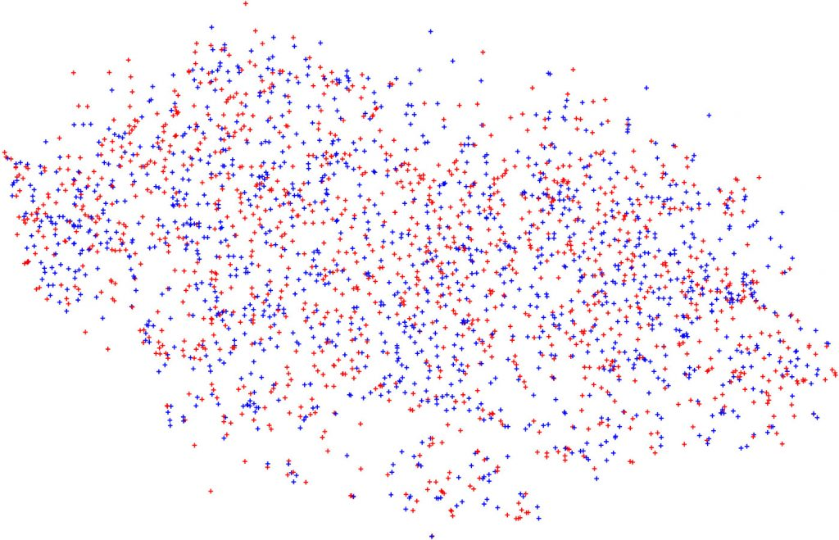
Stochastic Neighborhood Embedding (SNE)
t-SNE visualization of cat and dog images

Slide 25
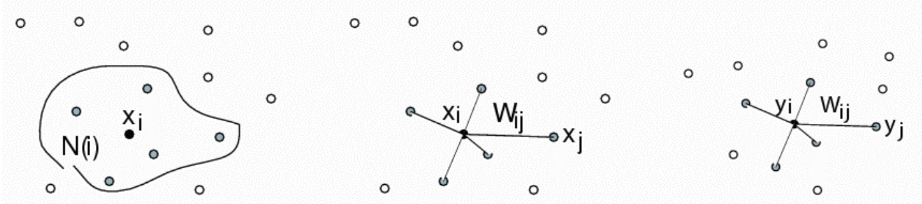
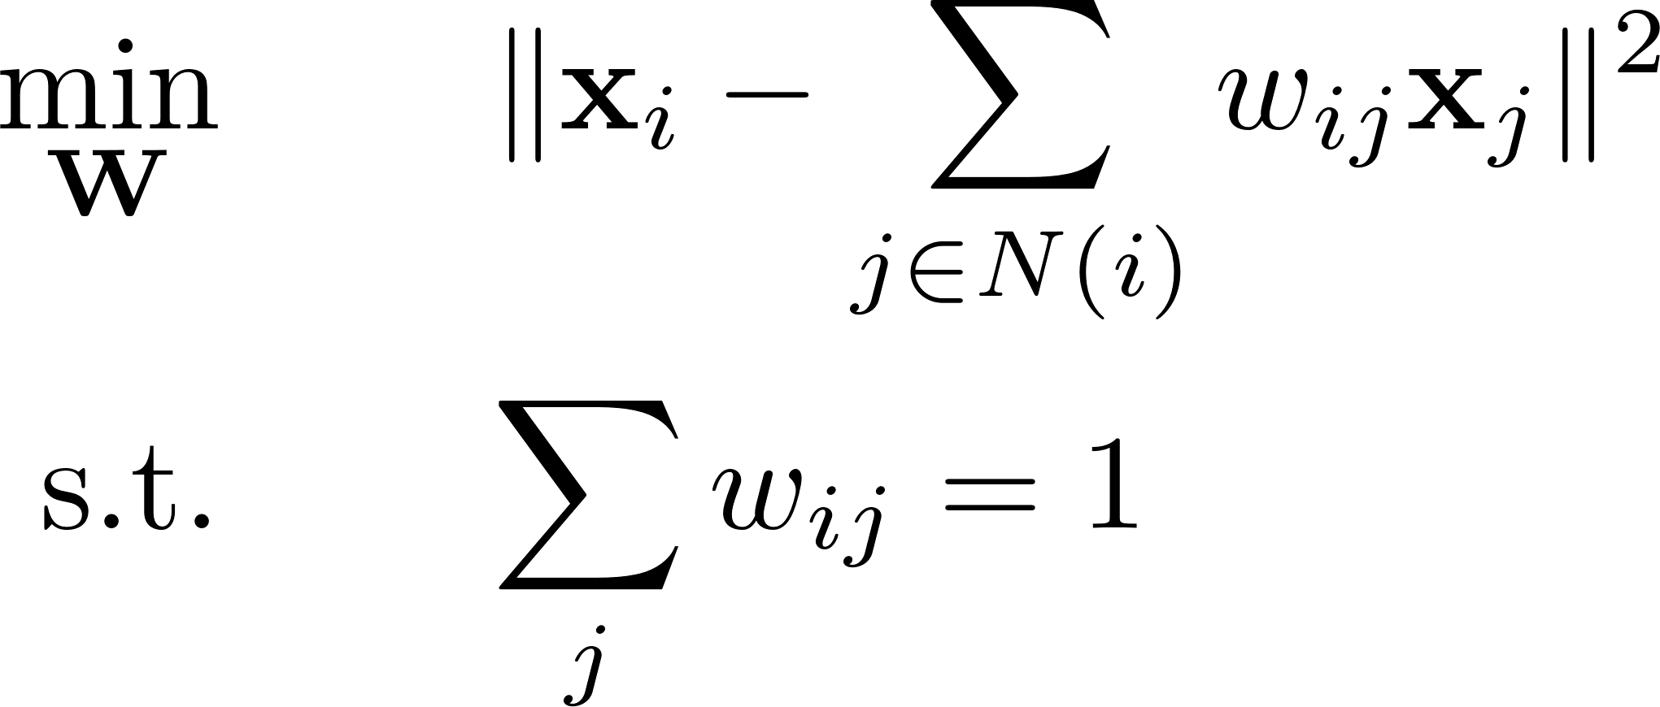
Local Linear Embedding (LLE)

Slide 26
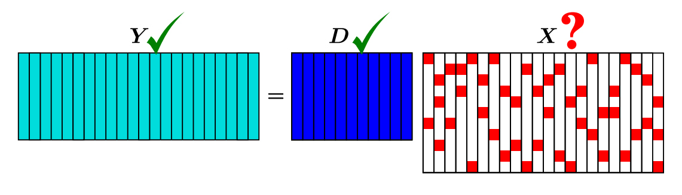

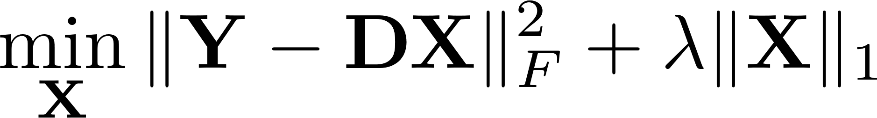

Sparse coding
Use sparse to represent :
Update and alternatingly
1. Fix , update
2. Fix , update

Slide 27
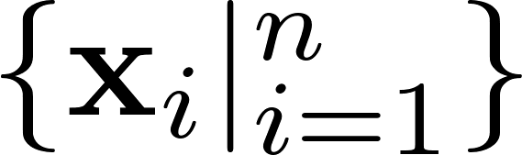
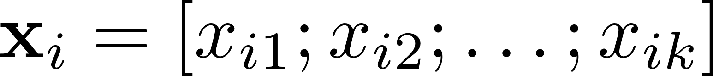

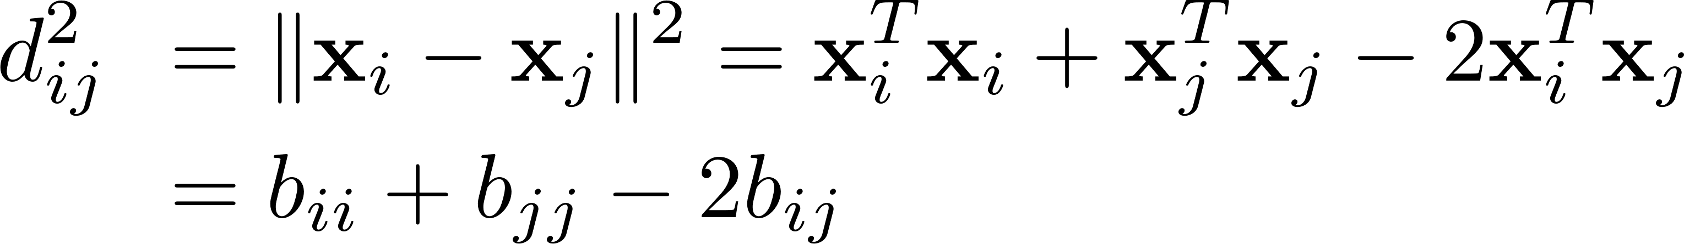
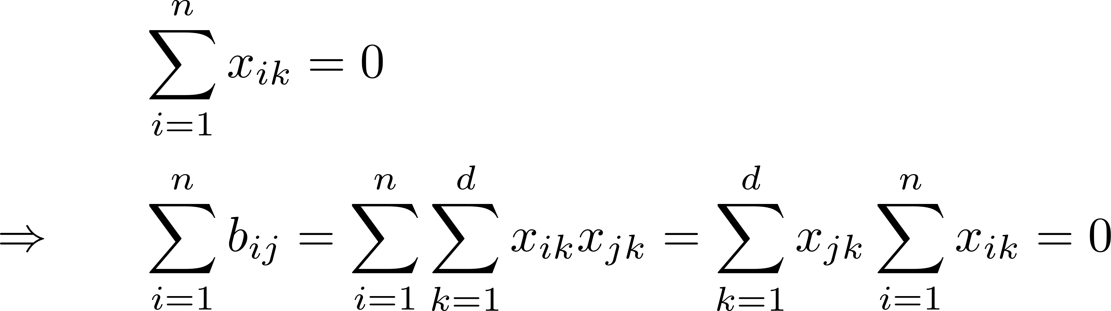
Multi Dimensional Scaling (MDS)
We have with .
By denoting
If are decentralized

Slide 28
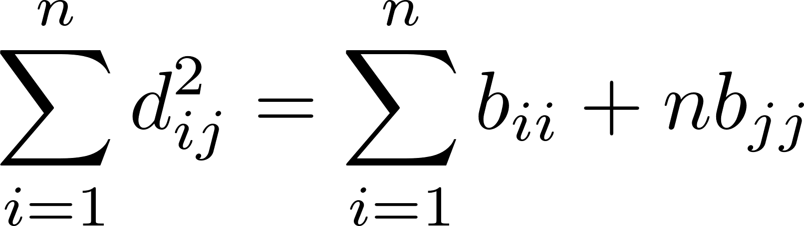
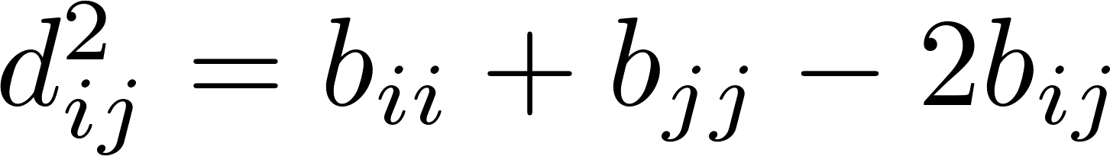
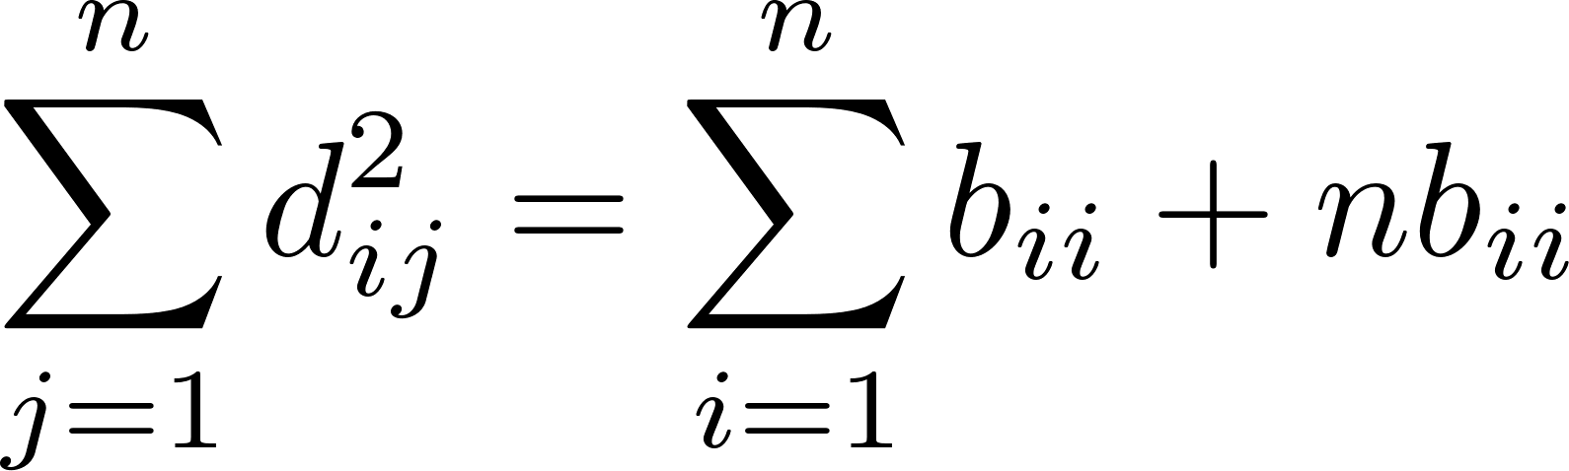
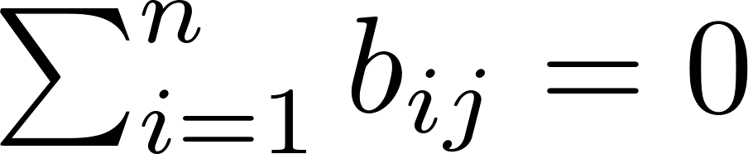
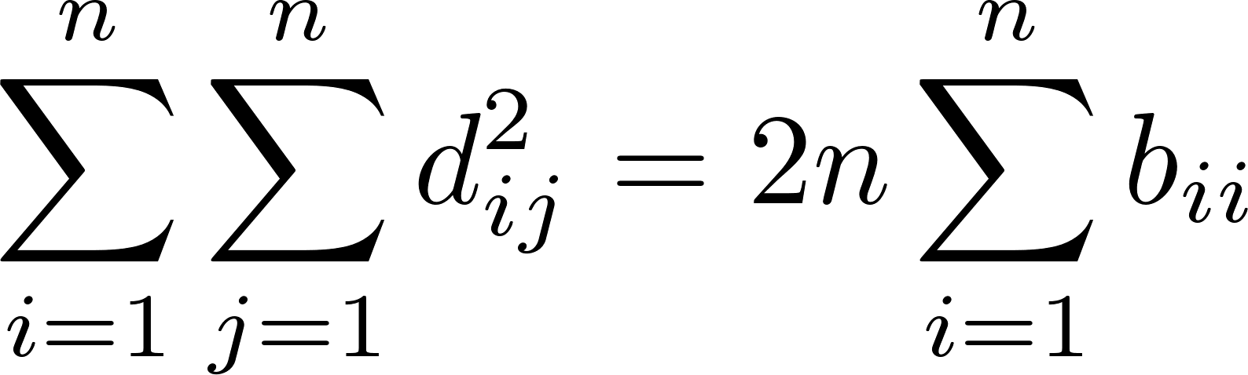
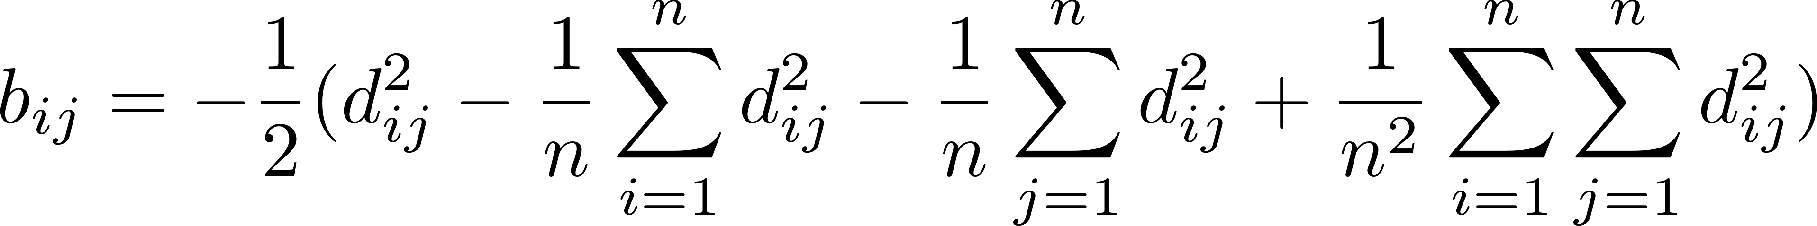
Multi Dimensional Scaling (MDS)

Slide 29
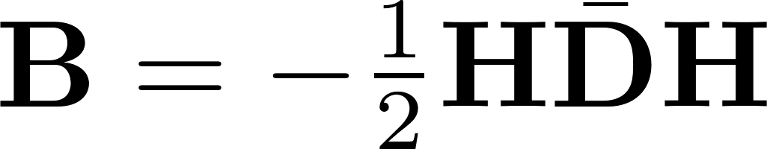
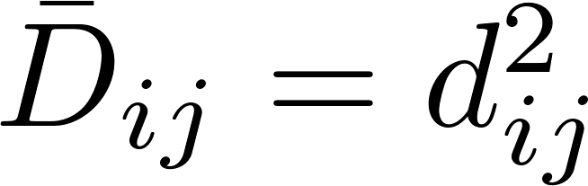



Multi Dimensional Scaling (MDS)
with and
Given distance matrix , we can calculate , and then obtain
based on

Slide 30

ISOMap
1. Constructing K-nearest neighbour graph G
2. For each pair of points in G, Computing shortest path: geodesic distance
3. Use Classical MDS with geodesic distance matrix

Slide 31

Auto-encoder
compressed data (feature)
original image
reconstructed image
encoder
decoder

Slide 32











Variational Auto-encoder
Auto-encoder
encoder
decoder
encoder
sample
decoder
reconstruction
Variational
Auto-encoder
encoder network
decoder network
regulate
reconstruct

Slide 33
Thanks!

